Slide 1
Diabetes Prediction
Rimsha (BSDSF21A027)
Habiba (BSDSF21A028)

Slide 2
Description
The Diabetes prediction dataset is a collection of medical and demographic data from patients.
This dataset can be used to build machine learning models to predict diabetes in patients based on their medical history and demographic information. This can be useful for healthcare professionals in identifying patients who may be at risk of developing diabetes and in developing personalized treatment plans.
Main Features:
Hypertension
Heart Disease
Smoking History
Hemoglobin
Blood Glucose Level

Slide 3
Methodology that we applied:
Logistic Regression
Support Vector Machines (SVM)
Decision Tree
Random Forest
Naïve Bayes Classifier
KNN Classifier

Slide 4
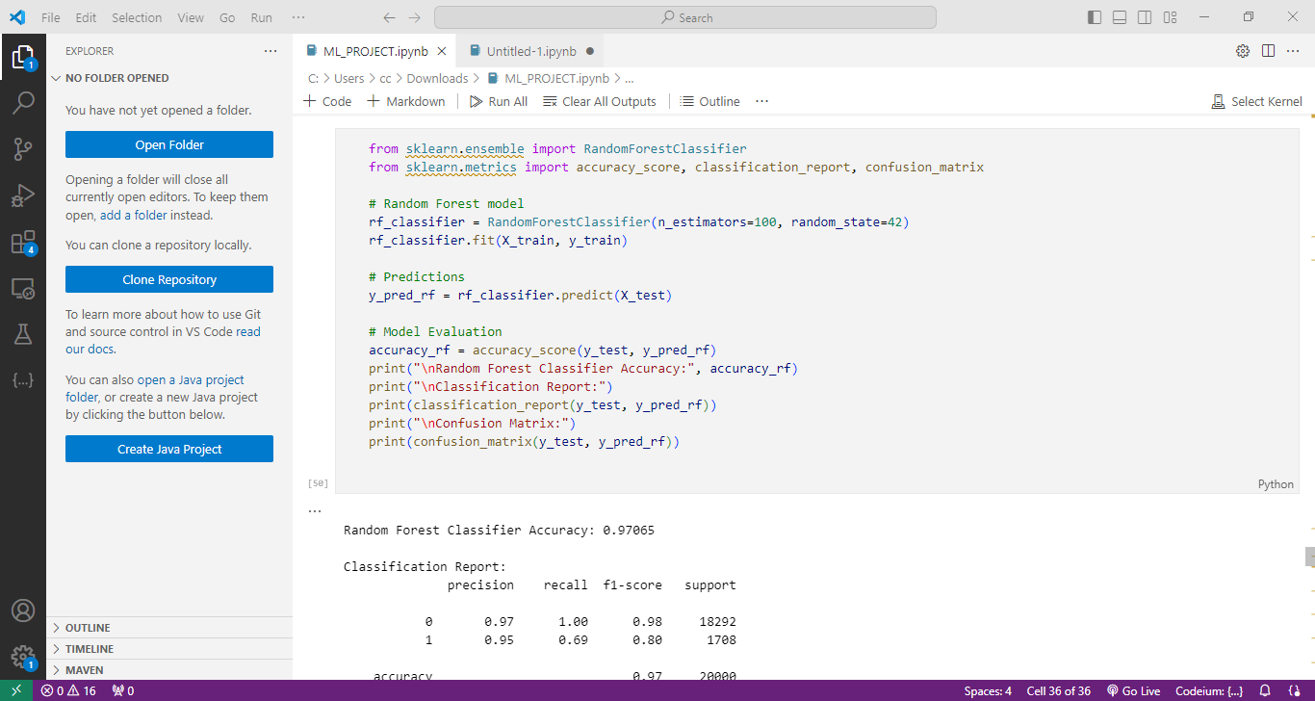
Our Best Model is Random Forest with highest accuracy 0.97065

Slide 5
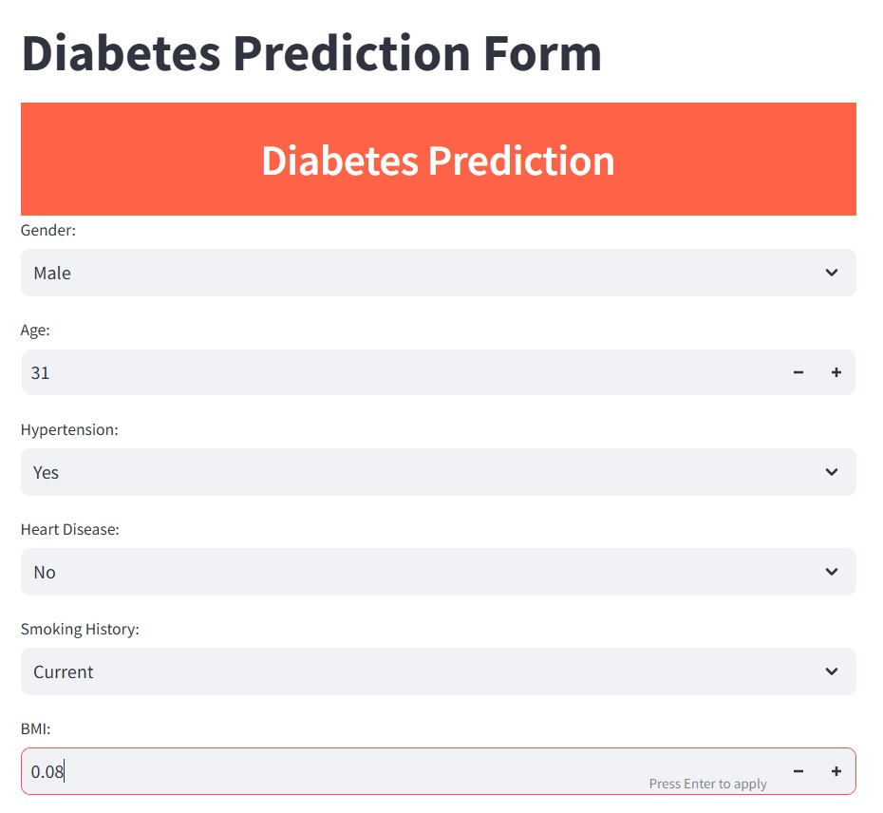
We have developed our project front-end using Streamlit,
and the output displayed in a yes or no format.

Slide 6
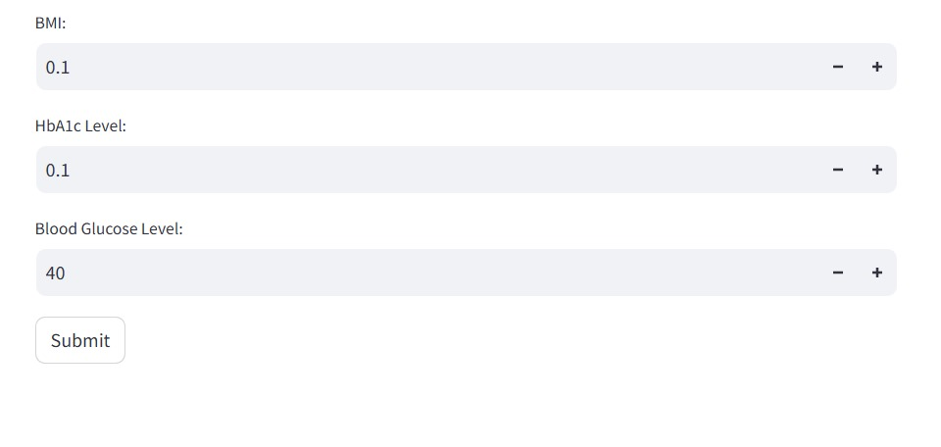

Slide 7
Business Scope
Healthcare Risk Assessment
Personalized Treatment Plans
Healthcare Insurance Risk Management
Research and Insights
Digital Health Solutions

Slide 8
Thank You

